Slide 1

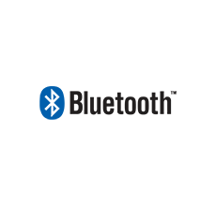

Slide 2
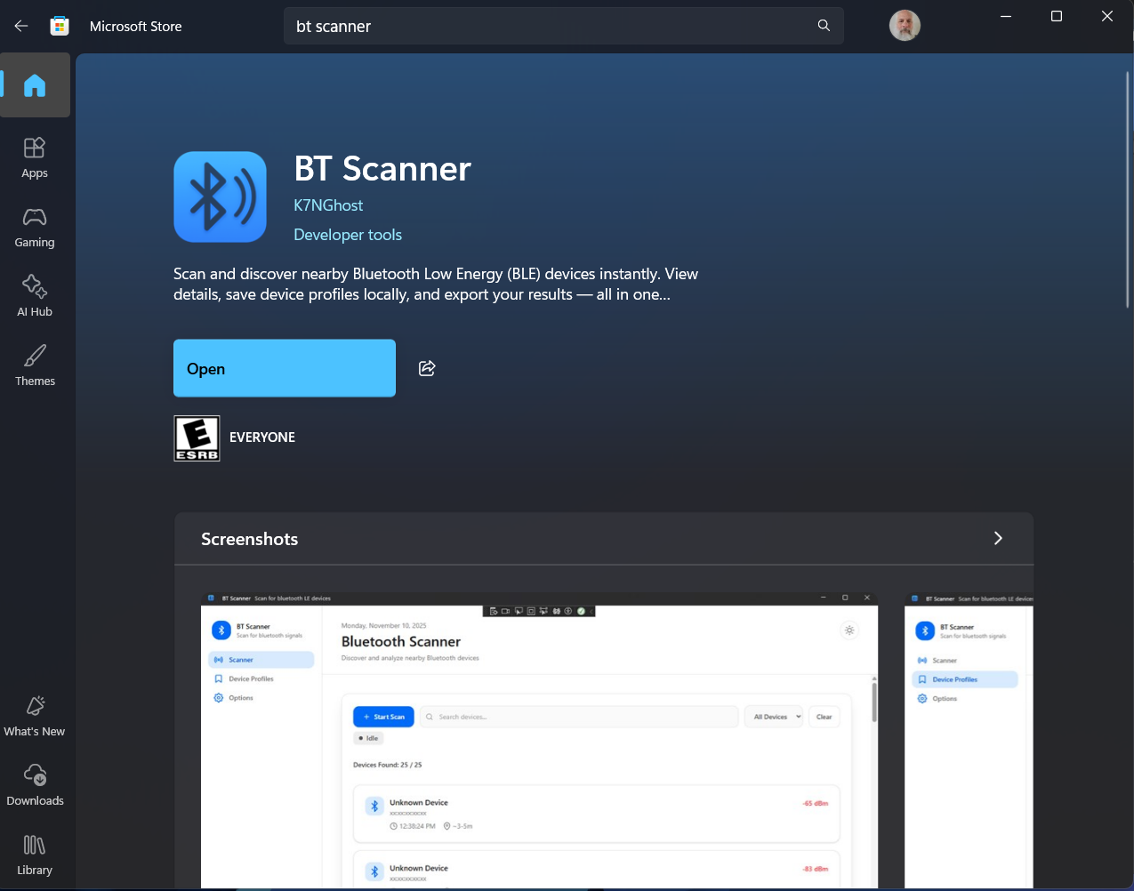
1. Getting Started
Find BT Scanner in the Microsoft Store and install it.
Bluetooth Security Windows PC

Slide 3
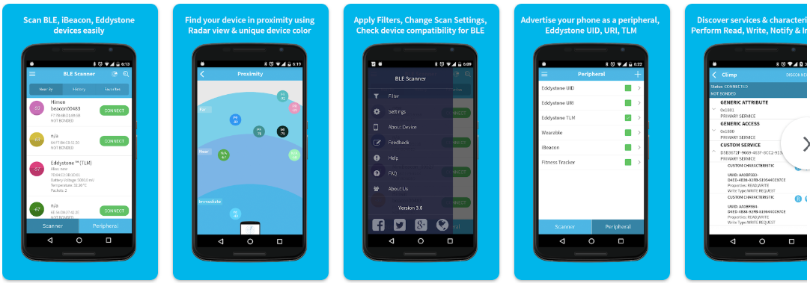
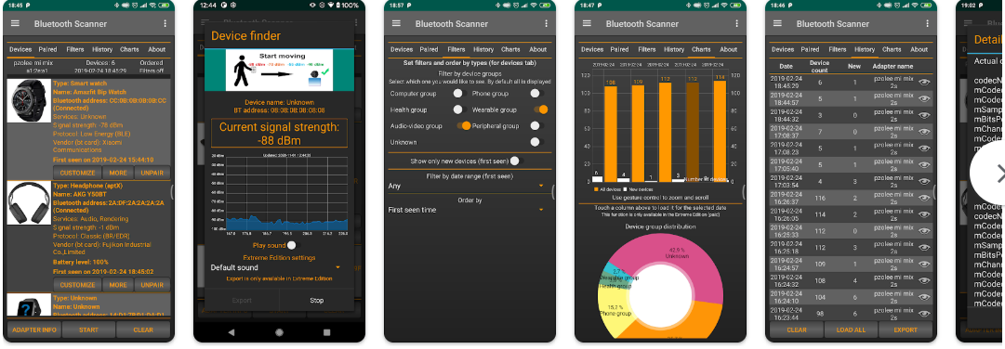
1. Getting Started
There are a few Bluetooth scanning apps available for Android (BLE Scanner, Bluetooth Scan).
Bluetooth Security - Android

Slide 4
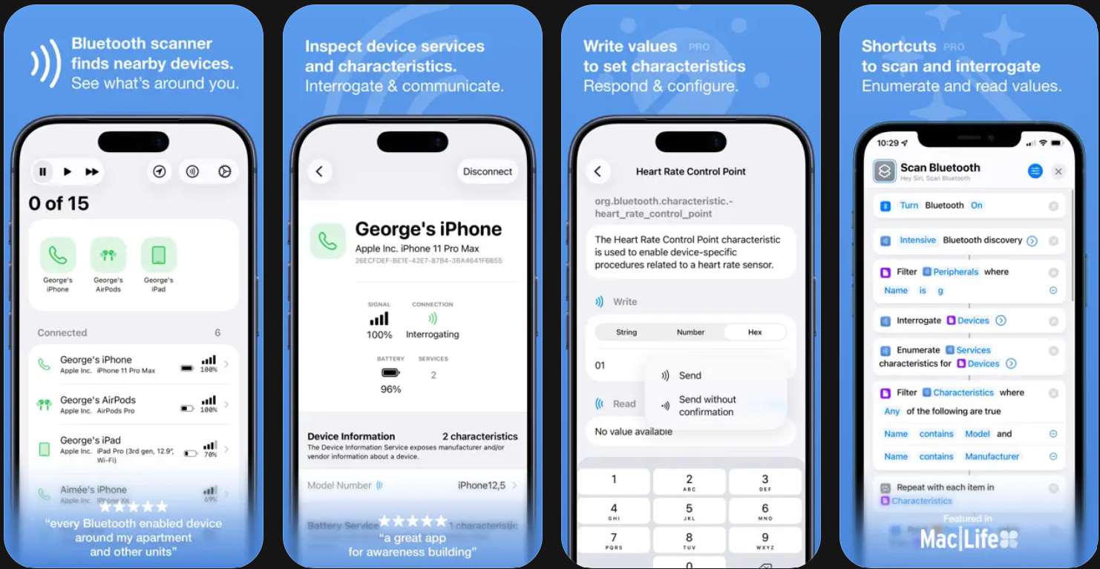
1. Getting Started
There are a few Bluetooth scanning apps available for Apple iPhone or Tablet.
Bluetooth Security - Apple

Slide 5
2. Bluetooth Scanning
A good first step for any type of security assessment is searching for nearby devices
We know that we have a target device in our area. The first thing we have to do is find that device.
Scanning for BT devices in our proximity will let us find the target device and it’s BT address
See if you can find your own person BT devices!
USB
VM

Slide 6
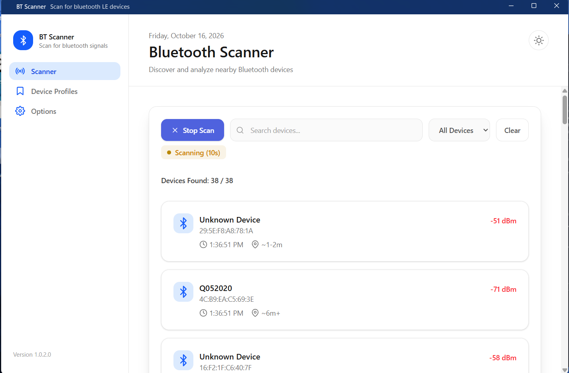
2. Bluetooth Scanning
Scanning for BT devices will show you devices in your area that are discoverable
Modern devices are usually non-discoverable by default, unless you are connecting/pairing with a new device

Slide 7
2. Bluetooth Scanning
You should be able to detect the target device (and some of your fellow students)
Be sure to note the target device’s BT address!
You’ll be using it a lot
USB
VM

Slide 8
A Note on BT Addresses and Scanning
Bluetooth Address
48-bit “unique” value
AA:BB:CC:DD:EE:FF
First 3 Bytes: Organizationally Unique Identifier (OUI)
  First 2: Non-significant. address Part
  Third: Upper Address Part
Last 3 Bytes: Lower Address Part
Normally invisible unless discoverable
Look it up here: https://maclookup.app/
*OUI =/= Chip manufacturer!

Slide 9
3. Enumerating Bluetooth Information
Now we’ve found the BT address of the target device. This is how we’ll address our information requests to it
We want to learn as much as possible about our target over Bluetooth
Keep in mind, all of this information is obtained before any pairing or authentication with the target
We just need to know its BT address
INFO?

Slide 10
Bluetooth (BT) Information
Basics
  Short range Wirelesss Personal Area Network (WPAN)
  Based on IEEE 802.15.1 Standard derived from Bluetooth SIG
  Named after Viking King Harald Bluetooth
  Co-exists with WiFi and cordless phones on 2.4Ghz band
  Applications include Headsets, keyboards, mice, serial links, networking, …
  Ad-hoc network not under any form of centralized control, pairing is called a piconet
  Driven more by marketing than engineering, low cost
  Wireless technology from 2.4 to 2.485 Ghz with 2.1 Mbps Enhanced Data Rate (EDR)
  Up to 10m, but potentially up to 100m (BT 5 potential to 400m) on 79 channels
  Power classes:
    100m (100mW)
    10M (2.5mW) - typical
    1M (1mW)
  Many versions (1.0, 1.1, 1.2, 2.0, 2.1, 3.0, 4.0 (LE), 4.1, 4.2, 5, 6, …)
  Complicated protocols leading to vulnerabilities in poor implementations
    Specification is 4x more complicated than for WiFi
  Frequency Hopping Spread Spectrum (FHSS) + Adaptive Frequency Hopping (AFH)
    Channel hopping invented by Hedy Lamarr
    Interference resistant
  BT 3.0 adds Alternate MAC and Phy (AMP) for 802.11 data transfer
Links
  Bluetooth Special Interest Group (SIG) https://www.bluetooth.com/
  https://en.wikipedia.org/wiki/Bluetooth
  https://en.wikipedia.org/wiki/List_of_Bluetooth_protocols

Slide 11
Bluetooth (BT) Information
Bluetooth Low Energy (BLE)
  Redesigned physical layer
  Faster network connection and termination
  Allows radio power down to save battery
  Short bursty data transfer applications up to 1Mbps
Bluetooth Protocol Stack (top to bottom)
  --- Host Software: ---
  PPP, IP Stack, Applications
  Bluetooth Profiles (RFCOMM, BNEP, OBEX) – Functions
    Radio Frequency Communications (RFCOMM)
    Bluetooth Network Encapsulation Protocol (BNEP)
    Object Exchange Protocol (OBEX)
    Headset audio
    Dial-up Networking
  Logical Link Control and Adaptation Protocol (L2CAP) – abstraction, packet fragmentation, reassembly, QoS function
  --- Interface: ---
  Host Controller Interface (HCI) – Layer between host and device (driver)
  --- Device Hardware/Firmware: ---
  Link Management Protocol (LMP) – Discovery, enumeration, setup, teardown
  Baseband Controller, Framing – Packet assembly, disassembly
  Radio Interface, RF Controller – Radio interface, channel changing, synchronization, modulation, demodulation

Slide 12
Bluetooth Security
Basics
  Security starts with 2.1 using SAFER+ block cipher using PIN and MAC
  Most devices use a static PIN such as 0000 or 1234
  Weak authentication
  Possible to identify non-discoverable devices and attack
  Older devices are less secure
  Long history of security concerns
Security Modes
  Node never initiates any security
  No link encryption, application-level security options
  Link encryption before any data is exchanged
Security Mode 3
  PIN mixed with MAC to generate 128 bit key
  SAFER+ cipher used to hash content for authentication
  Link key generated for subsequent authentication
  EO Cipher, similar to RC4, Stream XOR’d with plaintext to create ciphertext
  Uses Linear Shift Feedback Registers (LSFRs) for hardware adaptation
Security Tips
  Best security is to turn off Bluetooth when not in use
  Disable unneeded profiles
  Make non-discoverable
  Update software

Slide 13
Bluetooth Vulnerabilities
Attacks
  Classic Pairing Authentication (BTCrack v1.1)
    Guess PIN and key offline
  Classic PIN Cracking
    Capture initial pairing exchange
    Impersonate master or slave
    Transmit “not accepted”
    User is prompted to re-enter PIN
  BT MAC (BT_ADDR) might be one off from WiFi MAC
Known Exploits/Vulnerabilities
  BlueBorne https://www.armis.com/blueborne/
  Bluejacking https://en.wikipedia.org/wiki/Bluejacking
  Bluesnarfing https://en.wikipedia.org/wiki/Bluesnarfing
  General: http://airodump.net/bluetooth-security-vulnerabilities/
  DirtyTooth
    http://www.dirtytooth.com/
    https://www.elevenpaths.com/labstools/dirtytooth-para-raspberry-pi-2/index.html
CERT CVE Lookup
  http://cve.mitre.org/cgi-bin/cvekey.cgi?keyword=bluetooth
NIST Guidelines
  https://csrc.nist.gov/csrc/media/publications/sp/800-121/rev-2/draft/documents/sp800_121_r2_draft.pdf
SANS Whitepaper
  https://www.sans.org/reading-room/whitepapers/wireless/bluetooth-inherent-security-issues-945

Slide 14
Bluetooth Low Energy (BLE) Information
Bluetooth Low Energy (BLE)
  Classic BT became overly complicated
  Needed less overhead
  More competitive with ZigBee
  Redesigned physical layer
  Faster network connection and termination
  Allows radio power down to save battery
  Short bursty data transfer applications up to 1Mbps
Changes from Classic BT
  AMP just hands off to standard WiFi
  Gaussian Frequency Shift Keying (GFSK) instead of FHSS
  Separate radio, same antenna
  40 channels, next hop is mod 37
  BLE leverages GATT/ATT protocol for data exchanges, replaces RFCOMM
  Standardized protocol for all profiles to reduce overhead

Slide 15
Bluetooth Low Energy (BLE) Security
Security
  Pairing similar to Classic Bluetooth
  Keys are not retained, renegotiated each time
  Bonding retains keys
  LE 4.2 is most secure using Out of Band (OOB) pairing
Vulnerabilities
  “Just Works” mode is not secure (TK=0)
  Profiles are similar to Classic Mode 1
  Easy to find advertising devices, track and capture
  PIN cracking is easier if pairing exchange is captured
  Currently no way to force deauthorization
  Security left up to applications
  GATTacker is a Man-In-The-Middle (MITM) tool which spoofs both master and slave

Slide 16
Bluetooth Tools
Software
  Many, but these are the most notable ones
  Windows
    BlueScanner
    Bluetooth Analyzer (Microsoft)
      https://www.microsoft.com/en-us/store/p/bluetooth-analyzer/9wzdncrdhhw6?activetab=pivot%3aoverviewtab
    Bluetooth Viewer
      https://www.nirsoft.net/utils/bluetooth_viewer.html
    NRF Sniffer
  Android
    Bluetooth Scanner
    NRF Connect

